Slide 1
IFI marketing workshop
How and why to market to disabled people
Notes:
Name badges.
Thanks for attending the workshop today. I think it’s great that you’re looking to get more disabled people into your gyms. That’s a fantastic thing.
I’m John Ainsworth, and I work for a sports marketing agency called Make Sport Fun. We run marketing campaigns and marketing training for sport and activity. I used to run sports marketing campaigns for Sport England, and now at Make Sport Fun I run sports and activity marketing campaigns for charities, National Governing Bodies, councils and PCTs.

Slide 2
Format
Benefits of Marketing to Disabled People
Introduction
Defining our audience
Developing an inclusive marketing plan
Photos and examples of good marketing messages
Monitoring impact
Conclusion
Notes:
This is what we’re going to cover today. I want to make sure this workshop is as useful and relevant to you as possible, so we’ll start by talking about what your goals are, what resources you have and what problems you face. That will help me to tailor the information to what you need to hear.
We’ll talk through what the benefits are of marketing to disabled people.
We’ll define who our audience is, and understand a bit more about them.
Then I’ll show you the six stages of an effective activity marketing campaign. And we’ll go through specific tactics. These are all well-proven tactics within sports and activity marketing campaigns. So after today’s workshop, if you use what I show you then you will start to see more and more disabled people using your gym.
I’ll tell you where you can find resources for using in your marketing including marketing tools and free photos.
We’ll cover how to monitor impact of your marketing.
Then in the conclusion we’ll cover future developments.

Slide 3
Benefits of marketing to disabled people
Notes:
JULES TO COVER
Disabled people are a large part of your community and it makes great business sense to ensure they are thought about when marketing your facility and activities. Traditionally disabled people have been excluded from typical gym and leisure facility marketing and leisure providers have perhaps been caught up in battling for the same market share of existing gym users.
So with that in mind - here’s some useful statistics to use when trying to convince your centre or partners to put resources into marketing to disabled people.
It is estimated that disabled people have a potential spending power in excess of £80 billion per year.
There are 11 million people who are registered disabled, and many more who aren’t registered.
Around 40% of disabled people are in paid employment.
In a pilot project - £17,000 of additional income through gym membership across 11 facilities, each one on average. Plus secondary spend. Disabled people are more likely to work out with someone else such as a friend or family member. Disabled people are more loyal to gyms than regular users if they have a good experience. Derby college have got disabled gym members that have been there since they were accredited in 2005.

Slide 4
Your goals
Notes:
So we’re going to start with your goals.
Please write down your marketing goals for how many more disabled people you want using your gym in the next 6 months. If you don’t have specific goals, then have a think about what might be
Does anyone have set goals around this? WRITE ON FLIPCHART. Have discussion around what goals might be appropriate.
I’m going to cover a lot of ideas, resources, suggestions today. Which ones you use will depend on your own situation. There might be some parts where your facility is very strong, and there might be some parts where you particularly need help, in which case take lots of notes there about what to do.

Slide 5
Your challenges
Notes:
Now can you please write down what issues you’re facing? What’s currently stopping you from getting more disabled people active? Is it a lack of money, time, knowledge?
ASK PEOPLE TO SHARE AND WRITE ON FLIPCHART.

Slide 6
What you want to get out of today

Slide 7
The good news
Notes:
Now I’d like to focus on the good news. 3 bits of good news.
Firstly - According to a piece of research by Leonard Cheshire Disability only 16% of disabled people are gym members but 69% would like to be more active. So we’ve got a very big and very receptive audience if we get our marketing right.
Secondly - In terms of marketing the gym to disabled people - recent research from Sport England (APS6) suggests that keep fit/ gym activities are one of the most popular activities among disabled people.
Thirdly – I’m going to show you how to run a very effective marketing campaign today. Not going to wave a magic wand, but I will tell you exactly what you need to do. This is what I do every day for a living, and I use these tactics to get thousands of people active. Not easy, but it’s totally doable.
I'm going to tell you what's worked in our campaigns, and what’s worked in campaigns that other people have run. And as we go along there will be a chance to share what’s worked for people in this room.

Slide 8
6 stages of an effective activity marketing campaign
Notes:
Over the years that I’ve been running sport and activity marketing campaigns I’ve carefully tracked everything that’s worked for me, and what’s worked in campaigns that others have run. I’ve also studied all the research I can find about what is effective at increasing participation. What I’ve found is that there are 6 stages to an effective activity marketing campaign.
Let me explain what these mean.
Plan is about deciding on your target audience, objectives and budget
Set up is about setting up things in advance ready for when you start your campaign.
Recruit is your initial marketing to get someone’s attention and to get them to register their interest.
Intervene is about linking people with the ideal activity for them. There are normally many things they could do, and you need to help people find the right one for them.
Active participation is when they try the activity. We want to ensure that the first time is fun, free and friendly.
Review is about staying in touch with people to make sure they stay motivated, and to get them to start again if they stop.

Slide 9
Planning
Notes:
This is where we ask questions such as:
Who is your target audience?
How many people do you want to get active?
What is your budget?
How long have you got?
What resources do you have?
Let’s start with the target audience, and understand a bit more about who we’re targeting.

Slide 10
Defining the audience
Notes:
You’re disabled under the Equality Act 2010 if you have a physical or mental impairment that has a ‘substantial’ and ‘long-term’ negative effect on your ability to do normal daily activities. So that’s a physical or mental impairment that has a ‘substantial’ and ‘long-term’ negative effect on your ability to do normal daily activities.
What do substantial and long-term mean? Substantial is more than minor or trivial – e.g. it takes much longer than it usually would to complete a daily task like getting dressed. Long-term means 12 months or more – e.g. a breathing condition that develops as a result of a lung infection.
So, as I’m sure you know, disabled doesn’t just mean wheelchair users. In fact only 8% of disabled people are wheelchair users.
There are over 11 million disabled people in the UK. That’s more than one in 6 people.
More than 800,000 people in the UK are severely or profoundly deaf.
1 million adults have a learning disability
2 million disabled people have a visual impairment
Physical coordination = 2.7 million
Manual dexterity = 2.8 million
Lifting, carrying = 6.2 million
Mobility = 6.6 million
So by far the most commonly-reported impairments are those that affect mobility, lifting or carrying.
Mental health conditions are also a very common cause of disability in the UK. But the IFI scheme is more focussed around physical disabilities, so we’re not going to talk about that today.
Only 17% of disabled people were born with disabilities.
Does this surprise people? I think it’s a really important point, as understanding this affects the rest of our marketing planning.
This is actually going to be another piece of good news for many people here. If you’re doing any work around GP referral, or cardiac rehabilitation, then you’re already underway with getting disabled people in to your gym. Even if you didn’t realise that was what you were doing. So what works for them will work for getting most other disabled people in to your gym too.

Slide 11
Disabled people by age
Notes:
Statistics show that disability is much more prevalent in older age groups. Here’s the chart of what percentage of people from different segments are disabled.
Obviously we want to reach all disabled people, but we should focus most of our efforts on those segments with the highest percentage of disabilities.

Slide 12
People who go to the gym
Notes:
However, we know that historically these groups are not the people who go to the gym. So we need to do something different to appeal to them.

Slide 13
Disabled people by segment (over 55s only)
Notes:
If we focus on just the segments that are over 55 then we can see that even there it’s not even.
So Norma for example is a prime candidate.
STORY ABOUT HOW SEGMENTS WERE NAMED. TERRY USED TO BE CALLED DEREK.

Slide 14
Completely inactive
Notes:
74% of people who have a limiting disability do 0x30. v. 41% of people without a limiting disability
Only 18% of disabled people (1.66 million) participate in sport/ physical activity once a week compared to 39% of non-disabled people
The percentage of the population who are currently gym members hasn’t changed significantly over the last couple of decades and remains around 12%. http://www.marketresearchworld.net/index.php?option=com_content&task=view&id=164 (last accessed 18.01.2013)

Slide 15
Segmentation tool
Notes:
Segmentation tool can show us which of these segments live in our area. This is for the borough of Camden. You can access this at segments.sportengland.org.
Let’s say we choose Normas.

Slide 16
Segmentation tool
Notes:
It can now show us where the Normas live.

Slide 17
Marketing plans
Notes:
We can also understand who this segment is and how to market to her by going to http://www.promotingactivity.com/.
NOW GET ONE PERSON TO LOOK UP THEIR AREA, CHOOSE A SEGMENT AGED OVER 55, MAKE THE MAP OF WHERE THEY LIVE, AND LOOK AT THE MARKETING PLAN.

Slide 18
Case study – Go London Greenwich
Notes:
Let me give you an example of how this works in practice. We were running a project for NHS Greenwich.

Slide 19
Case study – Go London Greenwich
Notes:
Go London- Situation - In 2009 there was a London-wide campaign called Go London focussed on the over 50s. NHS Greenwich wanted to make the most of this opportunity to get as many over 50s active as possible.
Target Audience – We were able to analyse the Sport England segmentation and identify that the priority over-50 segments should be Brenda, Terry and Elsie & Arnold.
Objectives- We then set our objectives – Get Run an activity marketing campaign for people aged 50+ in Greenwich - with a focus on Brenda (46-55), Terry (56-65)and Elsie & Arnold (66+)

Slide 20
Case study – Go London Greenwich
Notes:
Maps- We were then able to load maps showing where our target audience lived, which meant we could target our marketing work to the right areas.

Slide 21
Case study – Go London Greenwich
Notes:
Marketing plans- Then we looked at the marketing communication plans which showed us how we should be running our marketing campaigns. What messages to use, what design style to use, how to write our media plan.
Bathroom salesman- I was showing this information to a sports club forum the other week, and a guy came up to me afterwards. He runs a cricket club, and works in marketing for a bathroom fitting company for a living. He was astounded that this kind of information was available for sport, and even more astounded that it was available for free! They pay an enormous amount of money for information about their audience, and it’s not even close to this thorough.
Lucky- We’re unbelievably lucky that it’s available for sport.

Slide 22
6 stages of an effective activity marketing campaign

Slide 23
Set up
Activity database
Website or booklet
CRM system
Ways for people to register

Slide 24
Activity database
Notes:
You’ve probably got more than one offer which is appropriate for disabled people. So if you’re going to be getting a lot of disabled people active then you’ll need to be able to find the right one for them quickly. People don’t just want to do an activity. They want to do an activity on a day that suits them, at a time they’re free, within 20 minutes of where they live. And if you don’t have the data about exactly when and where those sessions are taking place then you lose a lot of people.
Depending on how many activities you’ve got available you might use an excel spreadsheet or a website or an internal tool.
How is anyone doing this at the moment?

Slide 25
Campaign website and/ or booklet
Notes:
Next you need a campaign website and/ or a booklet for people to refer on easily. SHOW BOOKLET FROM LINCOLNSHIRE. Basically some way of people easily searching through what you’ve got on offer.
Here’s a screenshot of the website system we’ve developed. You can see that people can filter down their results by day and time as well as finding the group near to them.
If you’ve got a website you’ll need to make sure your website is firstly accessible to disabled users. When developing your website to ensure that it is accessible to your target market refer to RNIB guidance or refer to BS 8878 2010 Web Accessibility Code of Practice British Standard. For good examples of accessible websites visit: www.easyhealth.org.uk, www.disabledgo.com, www.rnib.org.uk and www.actiononhearingloss.org.uk.
Who’s made their website accessible? How much work was that?

Slide 26
CRM system
Notes:
Next you need to set up a CRM system, this is because you need some way of tracking who has registered and who’s been contacted. It’s much easier to use a basic CRM system than an Excel spreadsheet for multiple editors.
You’ve probably already got something like MRM or Legend. What’s anyone using?

Slide 27
Ways for people to register
Phone
Text
Online
Email
Freepost reply
Notes:
All of these need setting up.
So that’s the final step in setting up a campaign in advance.
Tools we use for these:
Phone – Chess for 0800 number. Text relay. Explain how this works.
Text – Esendex
Online – Formstack
Email – regular email
Freepost reply – in a recent campaign to over 55s we got 90% of the responses by freepost.

Slide 28
6 stages of an effective activity marketing campaign

Slide 29
Why marketing’s hard
Notes:
So one more thing that I want you to think through.
Please can you shout out anything you’ve had on your mind over the last 24 hours, apart from sport or activity. Anything at all. [if people don’t shout out then start it myself with dog was ill, where I’m going on holiday and the weather].
Now – if you’ve ever had a time in your life when you weren’t as active as you would like to be then tell me what stopped you from being more active. [if people don’t shout out then start it myself with injured ankle, socialising and the weather].
Now think of what other barriers there might be if you were disabled.
This is why marketing’s hard. People have got a lot of other things going on in their life, and getting active is hard. It is. It’s hard! We have to make it appealing, and make it easier for them. We have to help people to get started if we want to get them coming through the doors.

Slide 30
Marketing messages
Notes:
Inclusive marketing is about making disabled people feel inspired that a service or product is relevant and/or accessible to them.
Now we know that the majority of people who are disabled are over 55, are physically infirm, and have problems with mobility, lifting and carrying. So we’re going to primarily focus on them. We know that a lot of people see gyms as somewhere that young, fit, lycra-bound beautiful people go to work out. So we’ve got to make sure that we are showing through our marketing that the gym or the classes you have, are the right place for them. That means using the right messages, images and terminology.
The overall message to focus on isn’t on the health benefits. These are in the mix, but they’re not the main focus. Research shows that we shouldn’t be telling people why they should be active, as much as tell them the benefits of doing it. There was a huge meta-analysis done of how to promote behaviour change, and they found that the projects that were the most successful focussed on how to make the activity fun, easy and popular. Rather than making it boring, difficult and lonely. In fact that’s where our company name comes from. Make Sport Fun.

Slide 31
Marketing messages What not to say
Notes:
First off - you probably shouldn’t mention the terms disabled or disability. As that’s actually going to turn most people off. In a survey by Disability Action, 38% of those who said that they were not disabled went on to describe various disabilities which affect their lives. So people don’t consider themselves to be disabled. It’s not our job to tell them that they are. It’s our job to use the same words they use to describe themselves.
If you are going to say either one, then in the UK, the term "disabled people" is generally preferred to "people with disabilities". It is argued under the social model that while someone's impairment (for example, having a spinal cord injury) is an individual property, "disability" is something created by external societal factors such as a lack of wheelchair access to the workplace.^{[12]} This distinction between the individual property of impairment and the social property of disability is central to the social model.
All IFI faciliites should have received disability inclusion training. Might not have reached them yet. There is an online training course coming which will give you more information if you need it. If you’re not signed up to the EFDS newsletter then sign up and you’ll hear about this.

Slide 32
Marketing messages Motivations
Notes:
According to our research someone with a severe disability is likely to have the same motivations as those without a disability, but will have more barriers. So let’s look at what those motivations are for the over 50s.
A friendly, welcoming and fun environment.
A friendly and helpful instructor
Spending time with friends or their other half
Spending time with people like them
Feeling better and living longer
Taking pride in still being able to get active.
Weight loss.
Improve health
Get more energy
Reduce joint pain.
Improve well-being.
Improve recovery from injuries
Improve flexibility.

Slide 33
Marketing messages Motivations

Slide 34
Marketing messages Addressing barriers
Notes:
Now we need to look at the barriers we need to address.
Physical limitations. Including fatigue, strength, flexibility, balance and cardiac and pulmonary function. This is the top barrier to taking part in activity. And that’s ironic, because it’s also one of the main things that doing exercise is going to help them with. So we need to reassure people that they can go at their own pace, that the class is for people like them.
Time/ distance.
Don’t like being told what to do.
Fear of looking foolish.
Lack of support or guidance.
Cost.
Priorities.
Too hard or progressing too quickly.
Confidence.
So things to mention in your marketing are that you have the IFI mark, that you have accessible changing rooms, friendly, helpful staff. What else can people think of?
Bring assistant for free – reduces your costs, and makes a huge difference.

Slide 35
Marketing plans
Notes:
If you want to get even cleverer, you can target your messages to specific segments. We’ve written a marketing plan for each of the 19 Sport England segments, and you can download them from promotingactivity.com.

Slide 36
Marketing messages Norma
Notes:
For each segment it not only gives you the information from the Sport England pen portraits, but it also details which messages specifically appeal to that segment. So for Norma the key message to use is Support to help you get active. And the key barriers to address are health/ physical limitations (e.g. arthritis, back pain), and preconception barriers about all activities being too strenuous for her.

Slide 37
Marketing messages Kev
Notes:
And if you want to market to a younger segment then I’d like to reiterate that according to our research the motivations remain the same for people from a segment, it’s the barriers that are increased.
Kev is a 36-45 year old guy. The key motivations for Kev are Place club sport in its competitor set, the communal aspect to the sport or activity and the sociable aspect to after the sport. Key barriers for all Kevs are: is he going to look like a fool as a beginner? And are others going to take it as seriously as he wants to?
Then on top of that you’ll to address Kev’s barriers caused by his disability.

Slide 38
Marketing messages Specific groups
Notes:
If you’re marketing to a specific group then you’re going to want to use a similar messages for motivation. But you’ll want to address the barriers by emphasising what you’ve done to make the gym accommodating to that group.
For instance, the fact that the screens are usable by touch because it has tactile feedback.

Slide 39
Marketing messages Specific groups
Notes:
Or that you have different height counters if someone’s in a wheelchair.
What’s anyone’s thoughts about this? Does this make sense? Can you see what I mean?

Slide 40
Inclusive imagery
Notes:
One of the best ways to reassure people that the class is for people like them is to show appropriate inclusive imagery. If you can then obviously it’s ideal to get a professional photographer into your own facilities. But sometimes that’s too expensive. So to help you we’ve worked with the IFI to host hundreds of photos of disabled people in the gym. 360 high quality, high-resolution photos of people using IFI facilities – taken by a professional photographer. Free to download and use. We’ve also got another 400 plus photos of over 50s getting active.

Slide 41
Inclusive imagery

Slide 42
Inclusive imagery

Slide 43
Inclusive imagery

Slide 44
Inclusive imagery

Slide 45
Inclusive imagery

Slide 46
Inclusive imagery

Slide 47
Inclusive imagery

Slide 48
Inclusive imagery
Notes:
Who’s already using this photo library? How’s it working?
If you’re planning on doing this then write down who’s doing it and when on your checklist.

Slide 49
Formatting
Notes:
You will also need to ensure that marketing literature is relevant and accessible both visually and/or verbally to the target group. Here are the highlights from the See it Right pack, which you can get from the RNIB.
To promote your activity, ensure that it is in a large clear font (refer to See it Right), use inclusive imagery representing the target audience and provide contact details for email, telephone and textphone to ensure that communication is inclusive.
Where to get See it Right pack from.
order a copy by calling 0303 123 9999 or email shop@rnib.org.uk.
Making website more accessible.
Web accessibility code of practice – RNIB guidance. Info in the resource.

Slide 50
Formatting
Notes:
These are all fonts which you can use.

Slide 51
Formatting
Notes:
These are all ones which you shouldn’t use.
Write in 14 point or higher. For posters Research from the RNIB showed that there is an improvement of 30% in reading speed for every increase of 1 point above 10 point font.
Don’t use italics, underlining or block capitals.

Slide 52
Formatting
Notes:
Leave enough space between lines.
Left align text. Don’t centre it, don’t right align it and don’t justify it.

Slide 53
Formatting
Notes:
Make sure you’ve got a strong contrast between the text and the background. This is a example of bad contrast. Black on white is fine.

Slide 54
Notes:
So let’s run through what’s good about this. READ THROUGH COMMENTS ON THE SIDE.

Slide 55
Notes:
What could be improved on this poster?
Stronger enough contrast between letters and background in headline, sub-heading and text at bottom.
Better picture
Mention appropriate offers (e.g. bring along a
Mention alternative formats of poster
Mention that you’re IFI accredited
12 month contract – though that might be outside your control
Mention text relay
Change from italic

Slide 56
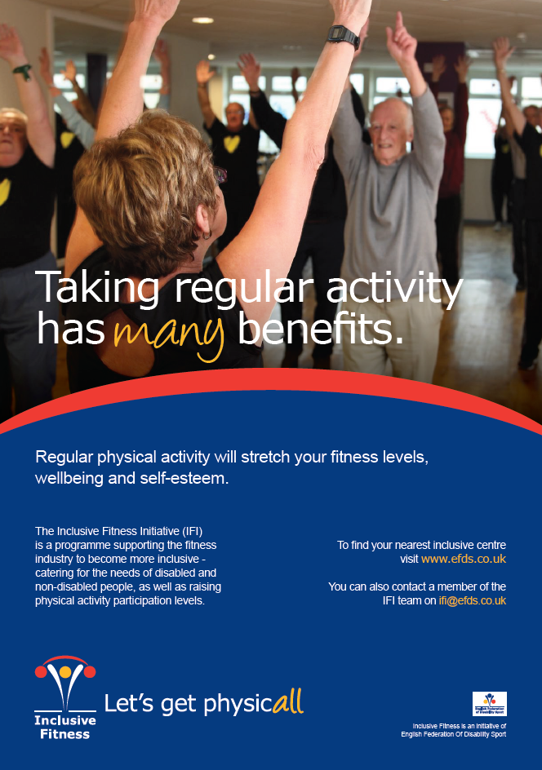

Slide 57
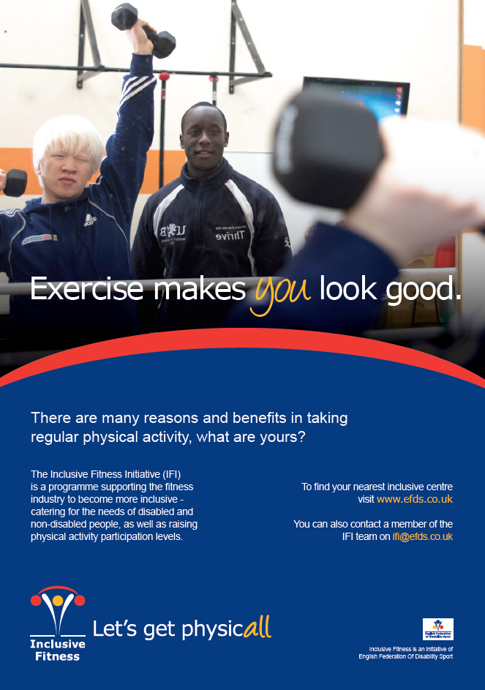

Slide 58
Your resources
Notes:
Please can everyone stand up.
come to the front if you like marketing, back if you hate it
come to the front if you spend 10 hours or more per week doing any kind of marketing (e.g. talking to groups, networking, asking people for referrals, online marketing, talking to partners, anything that’s focussed on getting more people through the door). So come to the front if you do 10 hours or more doing that, go to the back if you do 0 hours per week, and everyone else arrange yourself in between.
That’s great. Everyone please sit down again.
Marketing’s something that you need to put a good amount of time into. You need to do some every week. Luckily, however, it’s not THAT difficult. It’s not a piece of cake. But it’s not rocket science either. After all, if I can do it then it can’t be that hard.
Now please can you write down what resources you have available.
How much time do you have available? It’s not easy, going to take work.
What budget do you have?
What other resources do you have? Anybody internally who can help? Partners that you already work with that you can use to reach disabled people.
ASK PEOPLE TO SHARE SOME OF THEIR RESOURCES.
Write on flipchart.

Slide 59
Marketing tactics
Partnerships
Direct mail
Referrals
Search Engines
Notes:
Lots of what we’ve covered so far could be appropriate for just making your existing marketing inclusive. But if you want to get the message out to more older people or specific disability groups then these are the top 4 marketing tactics that I recommend.

Slide 60
Partnerships
Notes:
Let’s start with the over 55s. What are some partners you could work with to reach the over 55s?
Then give them my list.
Over 55s groups, or groups with lots of over 55s
Friendship club
Day centre
WI
Coffee mornings
Bridge club
Senior Citizen Group
Lunch club
Wives club
Bingo and activities group
Ladies social group
Over 50s social group
Men’s social group
University of the 3rd Age
Pensioner Action group
Lunch club
Weight watchers
Slimming World
Promote in your local Age UK shops or offices
Other older people’s charity shops or offices
What are some disability specific partners you could work with to reach disabled people?
Then give them my list.
Disability specific groups
local disability groups/ charities/ services/ organisations
Social Services (council), Day Centres (council), Gateway Clubs (learning disability clubs – via Mencap for example), Disability Sports Clubs (ParaSport, Spogo)
Hospital – explain work we did with Macmillan to get them referring people on
GP referral schemes
cancer referral schemes
cancer support groups
disability groups - where to find out about them
Carers (www.carersuk.org)
any groups at local council who are in contact with carers
any good charities to link in with. RNIB, Hearing, BHF – referrals.
People who benefit from specific services – e.g. Motability Schemes, health professionals, organisations that represent a specific impairment group. The vast majority of disabled people do not attend a specific group as identified above. There are however, ways in which you can reach large numbers of disabled people or target services that are more prevalently used by disabled people. By giving thought to the organisations that you target, you can empower respected givers of information to act as advocates on behalf of the facility.
Who’s already doing this? How’s it working?
If you’re planning on doing this then write down who’s doing it and when on your checklist.

Slide 61
Partnerships Macmillan Cancer Support
Notes:
We ran some research for Macmillan Cancer Support about how to market physical activity to cancer survivors. We then ran a campaign for them to promote one of their physical activity programmes. That campaign completely filled their programme (with 120 people over the first year).
We found that the most effective way to promote the campaign, by a long, long way, was to work through partners. Specifically the Cancer Nurses. We found that there were three things they needed to believe before they would refer someone on to the programme:
That physical activity was good for their patients
That the instructors were sufficiently qualified to deliver the programme
That it would be easy to refer someone on to the programme
To convince them of the first two we put together a presentation and Macmillan put together a report which convinced them of the benefits of physical activity. In the presentation we also covered the ways in which the instructors were qualified to deliver the programme. The delivery team met with them, and used this presentation to get them on board.
We also developed some very simple referral forms. These were A5 in size, and had a small amount of information on the left hand side, a form with space for a few details on the right hand side. A freepost address on the back, and a fax number on there. We found that 70% of health professionals used fax to send these in, so it’s vital that you have a fax number they can send to if you want to work with them.
Through the cancer nurses we also reached the cancer support groups. The delivery team presented to these groups in person, and on average 5 people would sign up from each group.

Slide 62
Case Study Lincolnshire
Notes:
Lincolnshire Sports developed a partnership between themselves, NHS Lincolnshire, Lincolnshire County Council, District Council and the local leisure providers to achieve the IFI Mark at 18 of its leisure facilities. I talked to the team up there to find out what was working for them and they said they focussed their marketing efforts on working through partners.
Specifically they focussed on the GP Referral programme and their disability forum. They ran a big campaign educating GPs, practice nurses and physios. They simplified all their offerings into a menu of what was available locally, and so the GPs could ask patients what they'd like to do. This included health walks, exercise referrals, cooking and growing. They then recorded a video with GPs and patients explaining the programme and what the benefits were to patients and to the GP practice in terms of financial savings. [SHOW VIDEO]. They also created a booklet with the same key information in for the GPs to refer to. [SHOW BOOKLET]. They don’t pay the GPs anything for referring people on. One of the big things that they discovered was that getting referrals from the GP practices was not something that you did once, and then it was in their system. They had to stay in touch with them, and follow up again and again. They had to build up relationships with the practices. They take existing users to meet with doctors, to explain how it changed my life. Regular engagement. Keeping it on the radar of people who will refer people on.
As a result of this work there are 103 GP surgeries in Lincolnshire, and 88 are now referring people on. It also massively increased the completion rate (from 50% to 68% completion rate which is a very good . good nationally).
People now understand what it is before they turn up.
The disability forum is a collection of all the local disability organisations who want to have a link with physical activity, and includes disability sports clubs and local charities. For working with the disability forum they again created a video which explained the benefits of IFI centres. Again they did a big initial promotion, and then constantly stayed in touch with those organisations to make sure they were referring people on. For some of them it took over a year before they started making referrals, but now that’s happening consistently.
Over the period of a year 900 disabled people joined the gyms with a total of 20,000 visits between them. This won them 1st place at the NHS Celebrating Success Awards in the Equality and Diversity category.
Lincolnshire Sports are also a good example of getting funding in from partners. They developed a partnership between themselves, NHS Lincolnshire, Lincolnshire County Council, District Council and the local leisure providers to achieve the IFI Mark at 18 of its leisure facilities. NHS Lincolnshire invested £340,000 in all areas of the IFI to support accessible gym provision for disabled people across the County. If you want to know more about how to get funding EFDS are working with UK Active to run some workshops around this.
SHOW RESOURCES FROM LINCOLNSHIRE.

Slide 63
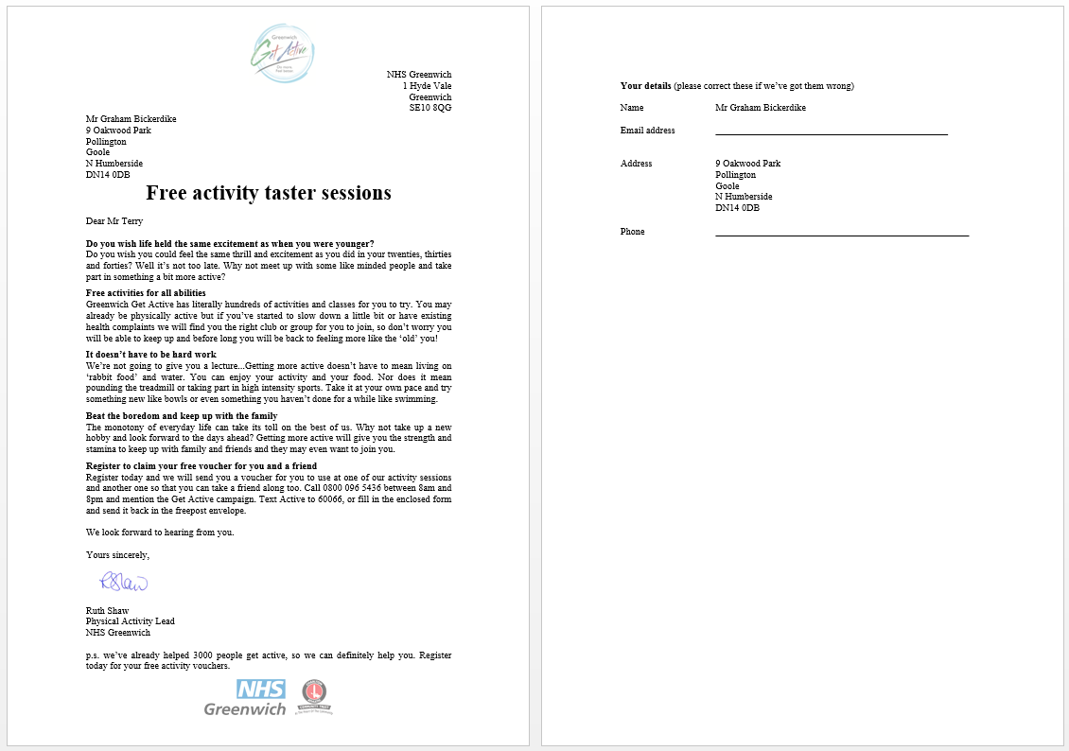
Direct mail
Notes:
Direct mail turns out to be a fantastic way to get people to register. Especially for the older segments. In East Riding we used direct mail recently to target Roger and Joys, and 9% of people we wrote to registered with us. A huge advantage with this is that you can buy a database of people who exactly match your target audience, so it’s incredibly focussed.
Go London Greenwich
GGA – offer of free first session
East Riding
Cost per person
We buy our data from a company called Selectabase (www.selectabase.co.uk) and we use a mailing house for sending the mailings out. But there’s also a service called Marketingguru which is broken down by interest.
Importance of having a reply envelope.
Who’s already doing this? How’s it working?
If you’re planning on doing this then write down who’s doing it and when on your checklist.

Slide 64
Referrals
Notes:
Referrals are a great add on to any campaign, as you can use people who’ve already registered to spread the word to their friends and family. The London Swimming campaign got about 7,000 registrations from referrals alone. That’s enough to fill the Albert Hall!
System that we use. SHOW LEAFLET THAT WE SEND TO PEOPLE TO GET THEM TO REFER FRIENDS OR FAMILY ON.
Some local authority exercise programmes actively encourage older disabled people to act as advocates, for example, visiting stroke clubs and other groups to promote fitness programmes for older people.
JULES TO TALK ABOUT INSTRUCTABILIITY.
Who’s already doing this? How’s it working?
If you’re planning on doing this then write down who’s doing it and when on your checklist.

Slide 65
Search Engines
Notes:
Advertise on external websites relevant to sport and disability i.e., Spogo, Disabledgo, Parasport
If you are an IFI Mark facility you will have a web page on both our website; EFDS – Inclusive Fitness and on Direct Enquiries website which has more than 1 million hits per month. And both these websites are visited by disabled people actively looking for accessible service provision and sport and leisure opportunities. Make the most of these opportunities and provide the IFI with details of any promotional work or PR you want to share on your website page.
Ensure that your search engine optimisation (SEO) is high and that people who are searching for ‘inclusive fitness’, ‘accessible gyms’, ‘gyms for disabled people’ are able to find you. Remember that most people search through Google and it’s free to have your facility details on the Google Maps directory.
You can even get a virtual tour of your centre added to Google using something called Google Business View. The Hawker Centre is an example of somewhere that’s done this. Costs about £500. Not only will these images appear on Google searches, Google Maps, and Google+ Local, but you can easily embed panoramic photos on your own website, social media pages, and more.
Who’s already doing this? How’s it working?
If you’re planning on doing this then write down who’s doing it and when on your checklist.

Slide 66
6 stages of an effective activity marketing campaign

Slide 67
Intervene
Notes:
Let me explain why this is so important.
Doctors were asked to consider the medical records of a 67-year old patient who had chronic pain in their hip from arthritis. None of the drugs they’d tried had worked, so they were considering hip-replacement surgery. This involves slicing open the thigh, wrenching the bone out of the socket, sawing off the arthritic end and replacing it with an implant. Recovery from this surgery is long and painful.
Then they found out that there was a drug which they hadn’t tried. 47% of doctors suggested they try the medication before considering surgery.
In a variation of this question instead of 1 medication there were 2 types of untried medication. Bizarrely they now found that only 28% of doctors now tried medication before considering surgery.
This strange story is due to people’s inability to deal with choice.
What we’re doing at the intervene stage is making it very easy for someone to find the right activity for them. Down to the day, time and type of session.
Vital stage. Need to give people the information they need. What kind of thing would someone who’s never attended a session need to know?
When, where, what to wear, where they can shower, what level the group is at, who to ask for. What else might people want to know. Make sure you’ve got all that info written down.
People are nervous. I decided once to go and join an athletics club. Now I’ve run since I was 13, mostly 5 mile cross country distance with the occasional marathon, but I’d never done athletics. I decided to improve my mile time so I went to my local club (Highgate Harriers) and I was terrified. I didn’t know if I’d have the right kit (I didn’t) I didn’t know if I’d be the slowest (2nd slowest) I didn’t know if they’d be friendly (they weren’t). So if that’s how it was for me as a runner, imagine how it is for someone who hasn’t run before. They’re terrified, and by reassuring people that it’s going to be ok you can get a lot of people to turn up.

Slide 68
In person
Notes:
You may need more persuasion to the get older disabled people to use your services so consider motivational interviewing training. It costs £350 per person for a 3-day introductory course.

Slide 69
Phone
Notes:
Ideal – get on the phone and call them.
This takes time, but people are much more likely to turn up if you talk to them.
Who’s already doing this? How’s it working?
If you’re planning on doing this then write down who’s doing it and when on your checklist.

Slide 70
Email or letter
Notes:
This is simpler, but not as effective. You’ll still need to send them all the relevant information we talked about before (time, place, what to wear, who to ask for, cost, etc.)
Who’s already doing this? How’s it working?
If you’re planning on doing this then write down who’s doing it and when on your checklist.

Slide 71
SMS
Notes:
Good as a reminder the day before or the day they come. We use a system called Esendex, because it allows us to schedule texts in advance, and it’s simple to use.
Who’s already doing this? How’s it working?
If you’re planning on doing this then write down who’s doing it and when on your checklist.

Slide 72
6 stages of an effective activity marketing campaign

Slide 73
Active Participation
Notes:
Try open days, taster sessions and visiting them in their environment (within a care or residential home).
Free, fun, friendly.
You’ve already got a great offer if you’ve got an IFI facility. If you haven’t then I’d obviously recommend you look into getting IFI registered.
Encourages word of mouth
Instructability
Nationally - the IFI work in partnership with ‘Instructability’ which is a Sport England funded project delivered jointly by Aspire and YMCAFit. The project trains and supports disabled people to become personal trainers. As part of their training delegates are required to complete a 12 week placement and as part of their role carry out community outreach to encourage more disabled people to participate in physical activity.
Research suggests that disabled people are more likely to use the gym if they have role models to look up to who are similar to themselves. With that thought in mind you may want to consider offering a disabled person a work experience placement or setting up a buddy scheme where disabled people support each other in their fitness goals.

Slide 74
Making it social
Notes:
Walking groups generally.
Local gym here. Cardiac rehab. They call it rehab, and one of the ladies told me her grandson begs her not to call it that. How they do it. Warm up in dance studio. Exercise – all at the same time.
Costa Coffee for walking group.
Matching people up with buddy in the group? You may wish to use existing people or recruit for new volunteers for this service in particular through your local volunteer centre or sports college. Visit www.do-it.org.uk to register volunteering opportunities. Don’t always assume that older people want buddies of the same age. Many older exercisers like to be around young people, so younger, responsible buddies can be recruited.
Who’s already doing this? How’s it working?
If you’re planning on doing this then write down who’s doing it and when on your checklist.
Info about disabled customers being more loyal. Derby College.

Slide 75
6 stages of an effective activity marketing campaign

Slide 76
Review
Notes:
How many people do you think you’ve had attend sessions, but who haven’t been in the last month? Those are the people who are most likely to come to future sessions. They were interested enough to attend at least once, and they’ll come again.
You need to track their name, email address and phone number, and you’ll want a column for notes about that person.
This takes work. But it’s very important.
Who’s already doing this? How’s it working?
If you’re planning on doing this then write down who’s doing it and when on your checklist.
OR CRM system if they have one.
MRM have got the IQ system which allows you to see who needs following up with.
Aqua Terra have got their own system called Context.

Slide 77
Phone
Notes:
Every couple of months you should be spending time on the phone calling people who haven’t been for a while. This takes time, but people are much more likely to turn up if you talk to them.
When we’re running a campaign we’re pointing people to all kinds of activity groups, so we don’t know if they’re going or not. We therefore get on the phone after 4 weeks to see how they’re doing, We call back again at 3 months, 6 months and 1 year. This is very important.
Who’s already doing this? How’s it working?
If you’re planning on doing this then write down who’s doing it and when on your checklist.

Slide 78
Email
Notes:
Alternatively you can email people to encourage them to come back to your group. This is in addition to the email newsletter, as this will be personal.
Who’s already doing this? How’s it working?
If you’re planning on doing this then write down who’s doing it and when on your checklist.
EMAIL NEWSLETTER? TELL THEM ABOUT MAILCHIMP IF PUTTING THIS IN.

Slide 79
6 stages of an effective activity marketing campaign

Slide 80
Monitoring impact
Notes:
You should already be monitoring the number of disabled users your centre has as a requirement of being an IFI centre. But it also helps you too.
It can really help with measuring return on investment and proving effectiveness. If you can show your impact then it’s easier to keep current funding. And if you can show that you know what works for attracting disabled people based on results it can help with getting more funding in.
Fusion Leisure introduced a process for getting more people using their leisure card, and doubled their disabled users. Now they didn’t really double the users, but they doubled the number that they knew about.
Additional benefits are that if you know who your disabled users are then you can talk to them about becoming advocates for your centre – to help spread the word to more people.
It also helps you improve your customer service. If you know someone has a visual impairment then you could potentially send letters to them in large print.

Slide 81
Resources
Notes:
In case you there’s anything from today’s workshop that you don’t remember, we’ll be providing
IFI resource
Make Sport Fun book
Disability equality training will give practitioners a broad understanding of disability, how to communicate terminology, etiquette, legislation, barriers and solutions to participation. EFDS currently deliver Disability Equality Training courses specifically for sport and physical activity and will be launching an online training course in the near future. See www.efds.co.uk/resources/training for further details.
Will also be a series of emails coming round with top tips about each of these topics. Over what period? Maybe one a month?
Will be calling up some of you to find out what you’re trying out. What you’re changing. What’s working for you.

Slide 82
Summary
Benefits of Marketing to Disabled People
Defining our audience
Developing an inclusive marketing plan
Free photos
Monitoring impact
Conclusion
Notes:
What’s been helpful?
What are you going to do differently?
What’s anyone going to try?
Now – what questions do people have?
So – now you should have a list of all the tactics you’re going to use. Choose 2 of them that you’re going to do on Monday and 2 more that you’re going to do the week after. Write those down separately. Now tell the person sat next to you how you’re going to do that.
ASK A COUPLE OF PEOPLE WHAT THEY’RE GOING TO DO.

